Slide 1
18CSS202J-CC UNIT –V
PREPARED BY,
A.JOTHIMANI
AP/CSE

Slide 2
TOPICS TO WEEK-1
FORWARDING
FORWARDING TECHNIQUES
INTERDOMAIN AND INTRADOMAIN ROUTING
EX:STATIC AND DYNAMIC ROUTING

Slide 3

PACKET FORWARDING
Delivery - Types ( Direct , Indirect)
Forwarding Techniques -
- Next -hop method
- Route Method
- Network specific Method
- Host specific Method
- Default Method
Forwarding Process:
-Forwarding by address aggregation
-Forwarding by label

Slide 4
Routing
-Routing Table contents
-Types of Routing - Static & Dynamic
( including tables).
Autonomous system
Intradomain & Interdomain routing

Slide 5
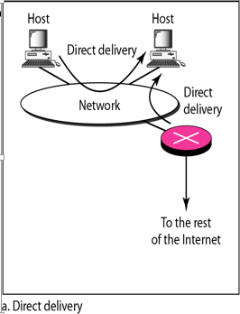
DIRECT DELIVERY
Direct Delivery
In a direct delivery, the final destination of the packet is a host connected to the same physical network as the deliverer.
Direct delivery occurs when the source and destination of the packet are located on the same physical network or when the delivery is between the last router and the destination host.

Slide 6
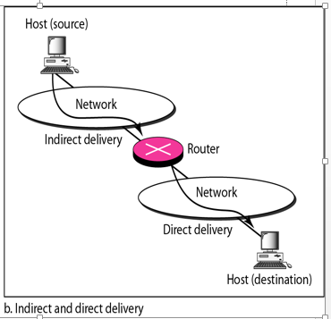
Indirect Delivery
If the destination host is not on the same network as the deliverer, the packet is delivered indirectly.
In an indirect delivery, the packet goes from router to router until it reaches the one connected to the same physical network as its final destination.
Indirect routing performed from one network to another network.
Destination network ≠ local network
Packet is forwarded to default gateway

Slide 7
Determining direct delivery
The sender can easily determine if the delivery is direct.
It can extract the network address of the destination (using the mask) and compare this address with the addresses of the networks to which it is connected. If a match is found, the delivery is direct.
When routing is performed in the same network than direct routing happens. Performed by Host. – Destination network = local network

Slide 8
Forwarding
Forwarding means to place the packet in its route to its destination.
Forwarding requires a host or a router to have a routing table.
Used in 2 cases
When a host has a packet to send or
when a router has received a packet to be forwarded, it looks at this table to find the route to the final destination.

Slide 9
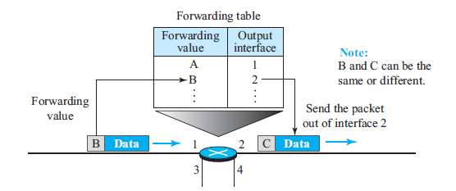
Forwarding process

Slide 10
FORWARDING TECNHIQUES
Forwarding can be defined as the action applied by each router when a packet arrives at one of its interfaces
A router normally uses decision making table for applying this action is sometimes called the forwarding table and sometimes the routing table.
When a router receives a packet from one of its attached networks, it needs to forward the packet to another attached network (in unicast routing) or to some attached networks (in multicast routing).
In order to make this decision, the router uses a piece of information in the packet header, which can be the destination address or a label, to find the corresponding output interface number in the forwarding table

Slide 11
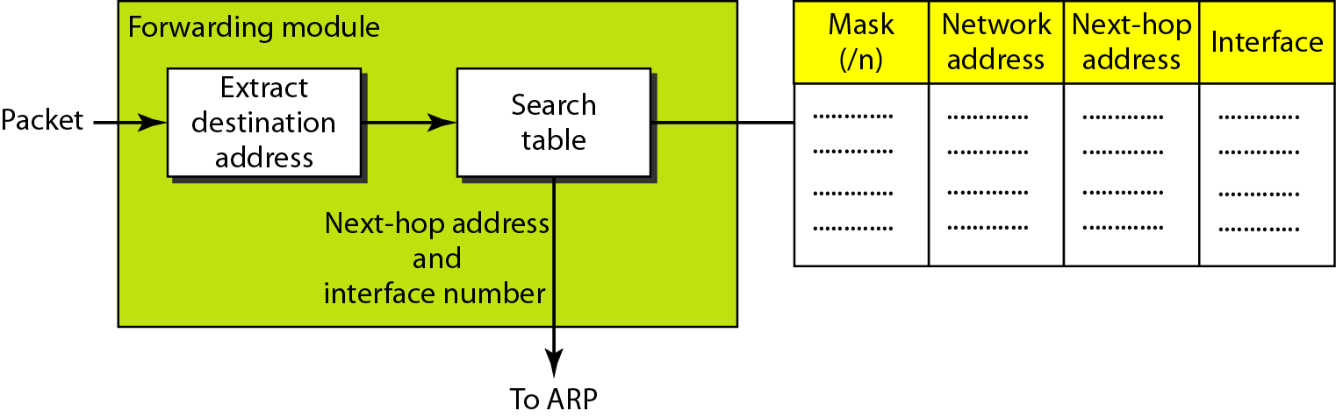
Forwarding Process
The hosts and routers use classless addressing because classful addressing can be treated as a special case of classless addressing.
In classless addressing, the routing table needs to have one row of information for each block involved.
The table needs to be searched based on the network address (first address in the block).
Unfortunately, the destination address in the packet gives no clue about the network address.

Slide 12
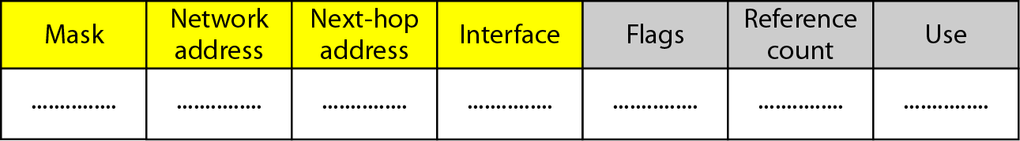
Figure Common fields in a routing table
Mask: Used for entry
Network address : Defines where the packet will delivered.
Next-hop address : defines the- address of the next router
Interface: Shows the name of interface
Flags
U(up): U flag indicated the router is up and running.
G(gateway): G flag means that the destination is in another network.
H(host-specific): H flag indicates that the entry in the network address is a host specific address.
D(added by redirection)
M(Modified by redirection)
Reference count
This field gives the number of users of this route at the moment.
Use
This field shows the number of packets transmitted through this router for the corresponding destination.

Slide 13
Forwarding Techniques
Next-Hop Method Versus Route Method
Network-Specific Method Versus Host-Specific Method
Default Method

Slide 14
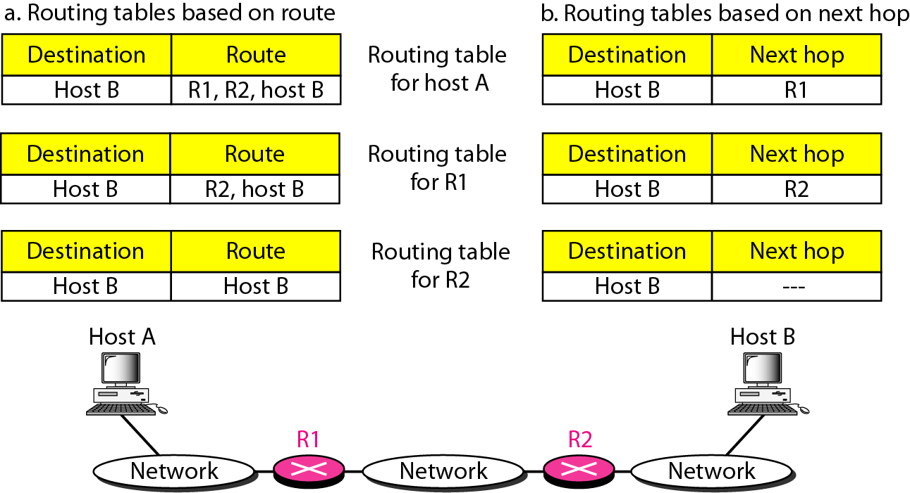
Next-Hop Method Versus Route Method
The routing table holds only the address of the next hop instead of information about the complete route (route method).
The entries of a routing table must be consistent with one another.

Slide 15
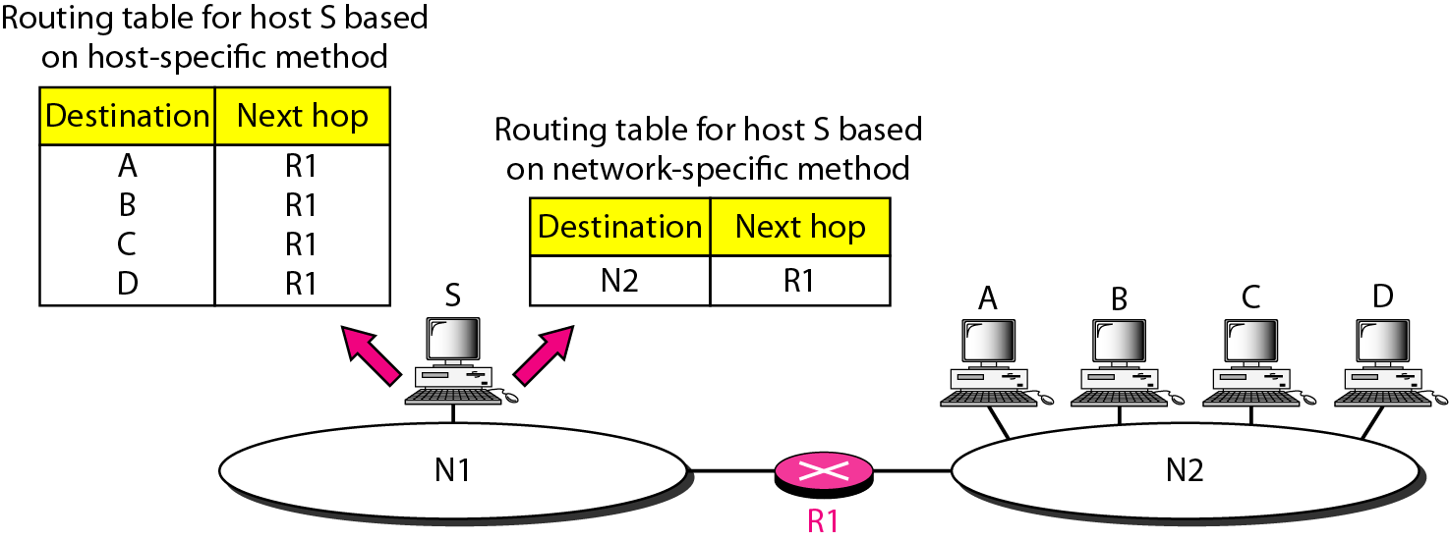
Network-Specific Method Versus Host-Specific Method
In order to reduce the routing table and simplify the searching process is called the network-specific method.
Instead of having an entry for every destination host connected to the same physical network (host-specific method), we have only one entry that defines the address of the destination network itself.
we treat all hosts connected to the same network as one single entity.

Slide 16
Host-specific method
The destination host address is given in the routing table. The rationale behind this method is the inverse of the network-specific method.
In the Figure, if the administrator wants all packets arriving for host B delivered to router R3 instead of R1, one single entry in the routing table of host A can explicitly define the route.
Host-specific routing is used for purposes such as checking the route or providing security measure

Slide 17
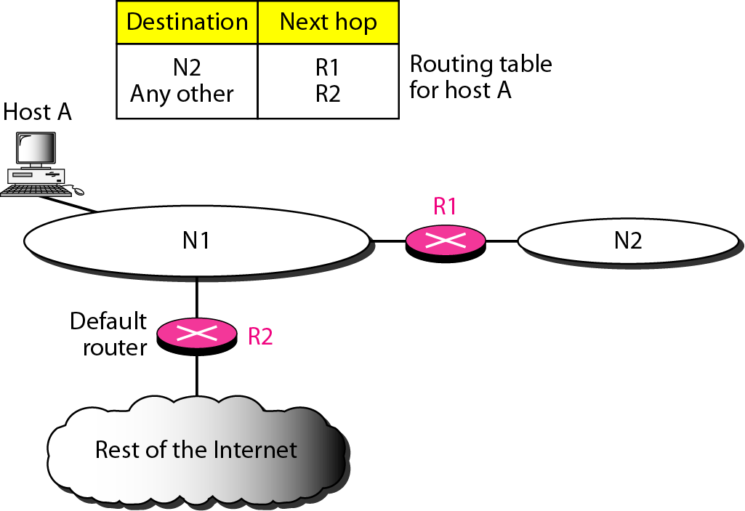
Default Method
In this hostA is connected to a network with two routers. Router R1 routes the packets to hosts connected to network N2.
However, for the rest of the Internet, router R2 is used. So instead of listing all networks in the entire Internet, host A can just have one entry called the default (normally defined as network address 0.0.0.0).

Slide 18
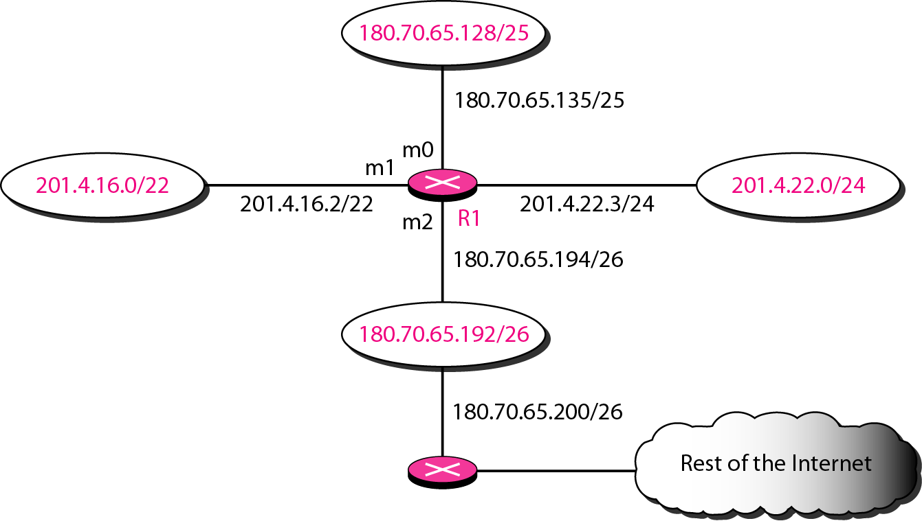
Example
Make a routing table for router R1, using the configuration in Figure.

Slide 19
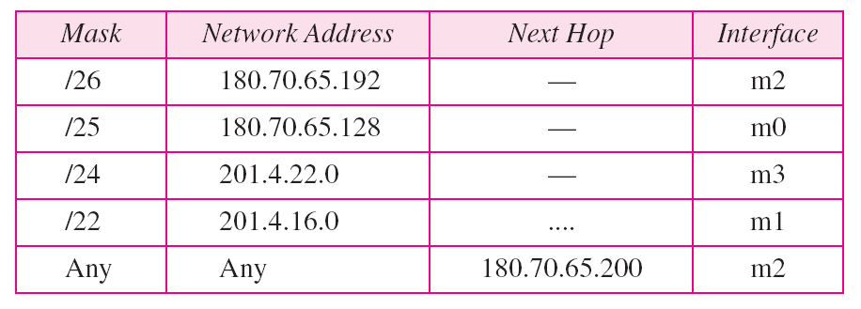
Table Routing table for router R1 in Figure

Slide 20
Routing Table
A host or a router has a routing table with an entry for each destination, or a combination of destinations, to route IP packets.
The routing table can be either static or dynamic.

Slide 22
Static route operation
Static route operations can be divided into these three parts:
Network administrator configures the route
Router installs the route in the routing table
Packets are routed using the static route
Since a static route is manually configured, the administrator must configure the static route on the router using the ip route command.

Slide 23
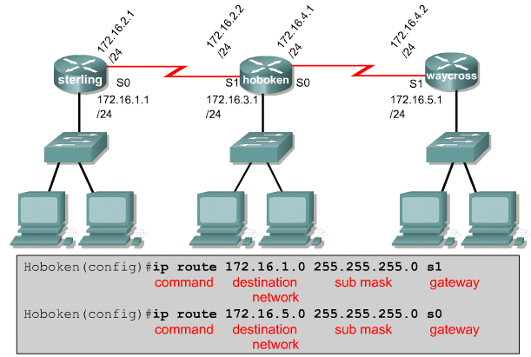

Slide 24
Verifying static route configuration
Use the following steps to verify static route configuration:
In privileged mode enter the command show running-configuration to view the active configuration.
Verify that the static route has been correctly entered.
Enter the command show ip route.
Verify that the route that was configured is in the routing table.

Slide 25
Advantages of static routing
-It can backup multiple interfaces/networks on a router
-Easy to configure
-No extra resources are needed
-More secure
Disadvantages of static routing
-Network changes require manual reconfiguration
-Does not scale well in large topologies

Slide 26
Dynamic Routing Table
It is updated periodically by using one of the dynamic routing protocols such as RIP, OSPF or BGP.
Whenever there is a change in the internet, such as a shutdown of a router or breaking of a link, the dynamic routing protocols update all the tables in the routers automatically.
The routers in a big internet need to be updated dynamically for efficient delivery of the IP packets.

Slide 27
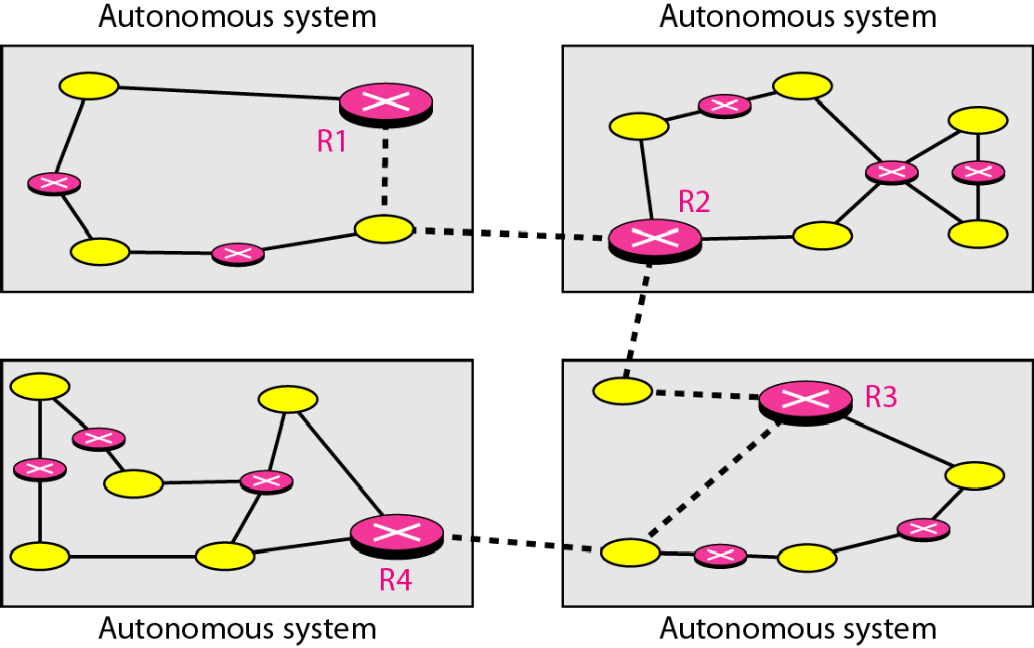
Autonomous systems
An autonomous system (AS) is a collection of connected Internet Protocol (IP) routing prefixes under the control of one or more network operators on behalf of a single administrative entity or domain that presents a common, clearly defined routing policy to the internet.

Slide 28
Goals: - ASes want to choose their own local routing algorithm - ASes want to set policies about non-local routing • Each AS assigned unique 16-bit number
Types of traffic & AS
• Local traffic – packets with src or dst in local AS
• Transit traffic – passes through an AS
• Stub AS - Connects to only a single other AS
• Multihomed AS - Connects to multiple ASes - Carries no transit traffic
• Transit AS - Connects to multiple ASes and carries transit traffic

Slide 29
Intra-domain routing
• Intra-domain routing: within an AS
• Single administrative control: optimality is important
–Contrast with inter-AS routing, where policy dominates

Slide 30
Intra-domain vs. Inter-domain routing –
Intra-: All routers under same administrative control
- Intra-: Scale to ∼100 networks (e.g., campus like SRM)
- Inter-: Decentralized, scale to Internet

Slide 31
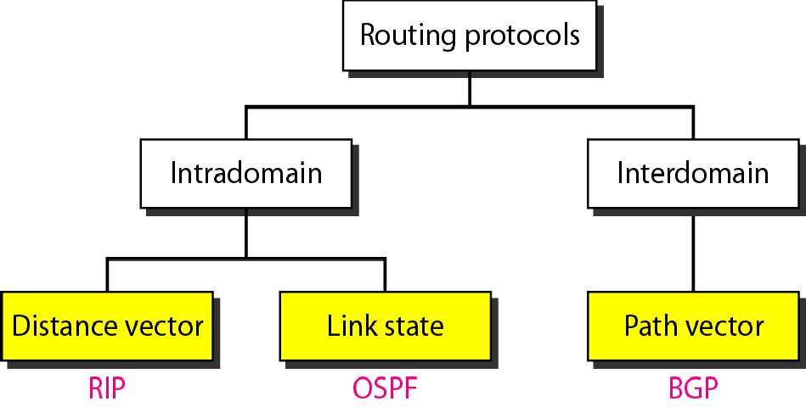
INTER-DOMAIN & INTRA-DOMAIN ROUTING PROTOCOLS TYPES
A routing table can be either static or dynamic. A static table is one with manual entries..
A dynamic table is one that is updated automatically when there is a change somewhere in the Internet..
A routing protocol is a combination of rules and procedures that lets routers in the Internet inform each other of changes..

Slide 32
THANK YOU

